Slide 1
JAVA BASICS
SPECIAL JAVA SUBJECT

Slide 2
Agenda
Java development procedure
Using Eclipse to develop Java project
Java basic concept
OOP with Java: Abstraction Encapsulation
String literal
System I/O
String format
DateTime structure object
Coding Convention

Slide 3
Agenda
More about class
Inheritance
Polymorphism
Abstract class and Interface
Value type/Referenced type
String class
Date/Time operators
MVC pattern

Slide 4
JAVA DEVELOPMENT PROCEDURE

Slide 5
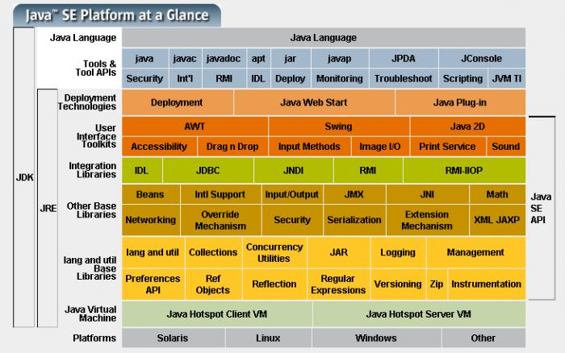
Java SE platform

Slide 6
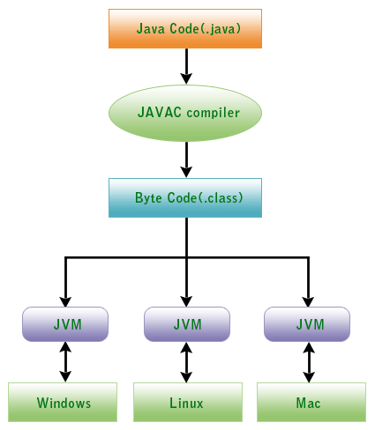
Java development procedure

Slide 7
JAVA PROGRAM STRUCTURE

Slide 8
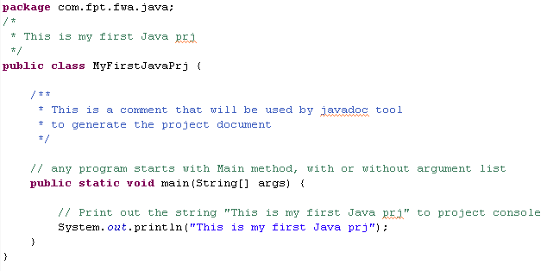
Java Program
Notes:
Present:
Comment
Structure
Statement
Keyword
String constant/literal

Slide 9
Java Program
Java is case sensitive
The keyword public is called an access modifier
The keyword class is there to remind you that everything in a Java program must be inside a class
The main method in the source file is necessary in order to execute the program
The System.out.println(..) is used to invoke method println of an object System.out

Slide 10
Java Program - Comments
System.out.println("We will not use 'Hello world!'");
// is this too cute?
/*
This is the first sample program
Copyright (C) by Cay Horstmann and Gary Cornell
*/
public class FirstSample {
public static void main(String[] args) {
System.out.println("We will not use 'Hello, World!'");
}
}

Slide 11
USING ECLIPSE

Slide 12
Agenda
Create a new Java console project
Insert Java code into the new Java code file
Run the new Java console project
View the running result

Slide 13
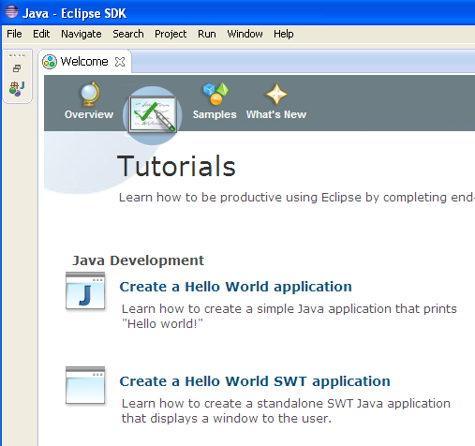
Java Tutorial with Eclipse

Slide 14
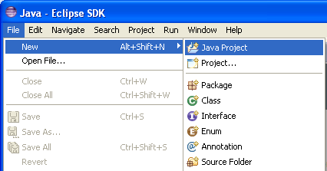
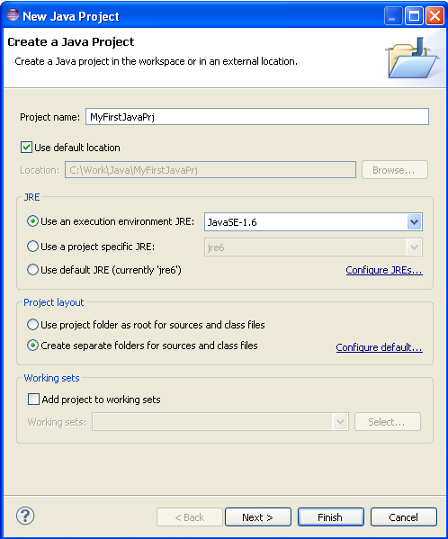
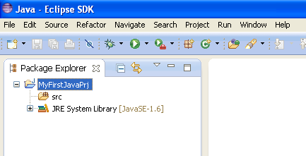
New Java project

Slide 15
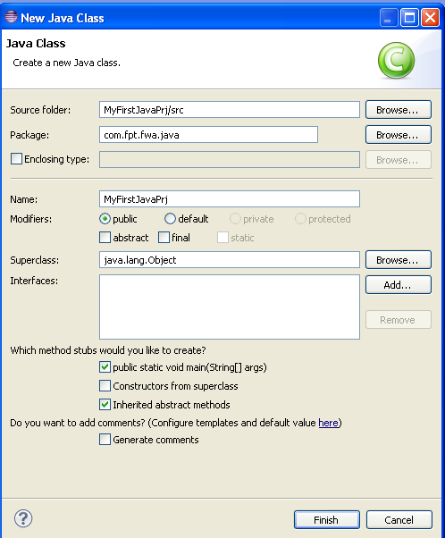
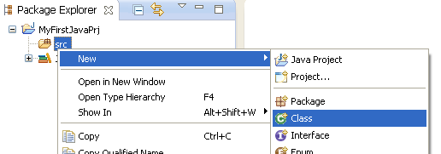
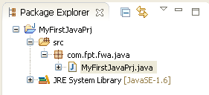
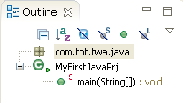
New Class
Notes:
Present: Default structure, class file.

Slide 16
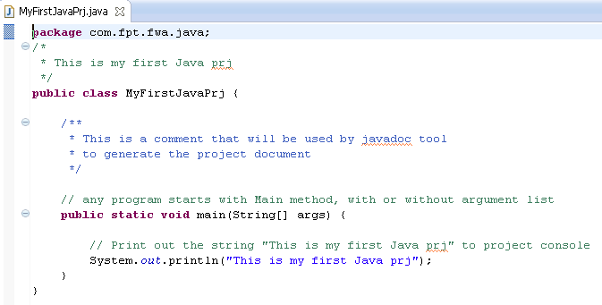
First project

Slide 17
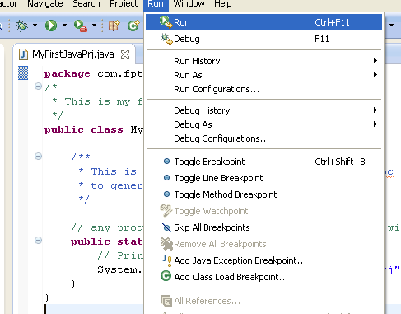

Running/Debugging

Slide 18
Summary
Create a new Java console project by the new project function
Insert Java code into the new Java code file
Run the new Java console project by debug function
View the running result

Slide 19
JAVA BASIC

Slide 20
Agenda
Key words
Primitive types
Variable: simple and array
Operators
Flow control statements
Branching statements
Iterate statements

Slide 21
Legal Identifiers
Identifiers must start with a letter, a currency character ($), or a connecting character such as the underscore ( _ ). Identifiers cannot start with a number!
After the first character, identifiers can contain any combination of letters, currency characters, connecting characters, or numbers.
In practice, there is no limit to the number of characters an identifier can contain.
You can't use a Java keyword as an identifier
Identifiers in Java are case-sensitive; foo and FOO are two different identifiers.

Slide 22
Keywords
abstract | continue | for | new | switch
assert | default | goto | package | synchronized
boolean | do | if | private | this
break | double | implements | protected | throw
byte | else | import | public | throws
case | enum | instanceof | return | transient
catch | extends | int | short | try
char | final | interface | static | void
class | finally | long | strictfp | volatile
const | float | native | super | while
Notes:
In red not mention in this course

Slide 23
Java Code Conventions
Classes: the names should typically be nouns
Dog
Account
PrintWriter
Interfaces: the names should be adjectives
Runnable
Serializable
Methods: the names should be verb-noun pairs.
getBalance
doCalculation
setCustomerName

Slide 24
Java Code Conventions
Variables: Like methods, starting with a lowercase letter. Sun recommends short, meaningful names, which sounds good to us. Some examples:
buttonWidth
accountBalance
myString
Constants: Java constants are created by marking variables static and final. They should be named using uppercase letters with underscore characters as separators:
MIN_HEIGHT

Slide 25
Data Types
Java is a strongly typed language. This means that every variable must have a declared type. There are eight primitive types in Java
Four of them are integer types; two are floating-point number types; one is the character type char, used for characters in the Unicode encoding, and one is a boolean type for truth values.

Slide 26
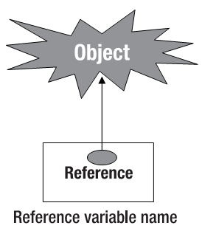
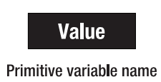
Variables and Data Types (cont.)
Data types
Primitive types
Reference types
The primitive types are boolean, byte, char, short, int, long, float and double
All non-primitive types are reference types, so classes, which specify the types of objects, are reference types

Slide 27
Primitive Data Types

Slide 28
Primitive data types
Integral – default 0: byte, short, int, long (0L)
Default integral number type is int
Decimal: float (0.0f), double (0.0d)
Default floating point number type is double
Boolean: boolean (false)
Character: char (‘\0’)
String: string (null)
Notes:
Integral type has MAX_VALUE and MIN_VALUE => overflow exception or casting error
Memory capacity => Precision and range of each number type

Slide 29
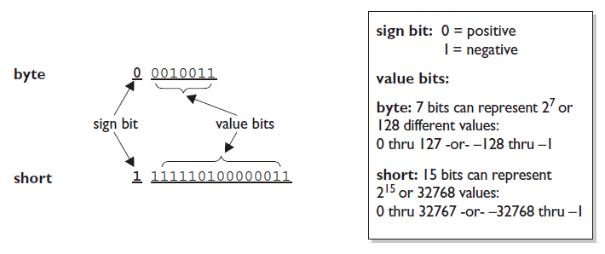
The Sign bit for a byte
All six number types in Java are signed
Integer literals three way store present integer numbers in the Java language: decimal(base10), octal(base8), hexadecimal(base16)

Slide 30
Variables and Data Types (cont.)
Decimal Literals: default
int length = 343;
Octal Literals: represent an integer in octal form by placing a zero in front of the number
int nine = 011;
Hexadecimal Literals: including the prefix 0x or the optional suffix extension L
int z = 0xDeadCafe;
Note: Java will accept capital or lowercase letters for the extra digits in hexadecimal
0XCAFE and 0xcafe are both legal

Slide 31
Variables and Data Types (cont.)
Floating-Point Literals:
Default are defined as double (64 bits)
Attach the suffix F or f to the number if want using floating-point (32 bits)
Example:
float f = 23.467890; // Error
float g = 49837849.029847F;
Boolean Literals
true, false
Character Literals: 16-bit unsigned integer
char letterN = '\u004E'; // The letter 'N‘

Slide 32
Variables and Data Types (cont.)
Some special characters
\n: Used to denote new line
\r: Used to denote a return
\t: Used to denote a tab
\b: Used to denote a backspace
\f: Used to denote a form feed
\': Used to denote a single quote
\": Used to denote a double quote
\\: Used to denote a backslash
Literal Values for Strings: A string literal is a source code representation of a value of a String object
String s = "Bill Joy";

Slide 33
Variables and Data Types (cont.)
Accessing Variables: you can access it by referring to it by its name
x = y;
assign y’s value to the variable x
access the variable y

Slide 34
The Character Type

Slide 35
Variables
In Java, every variable has a type. You declare a variable by placing the type first, followed by the name of the variable
Variable Type
Variable Name
int total;
int count, temp, result;
Multiple declarations on a single line
A variable name must begin with a letter, and must be a sequence of letters or digits.
Symbols like '+' or '©' cannot be used inside variable names, nor can spaces

Slide 36
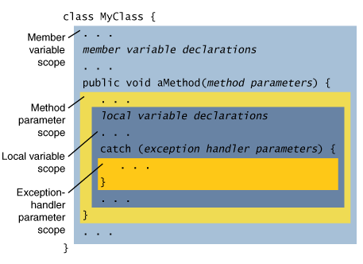
A variable's scope

Slide 37
A variable's scope
public static void main(String[] args)
{
int n;
. . .
{
int k;
. . .
} // k is only defined up to here
}
public static void main(String[] args)
{
int n;
. . .
{
int k;
int n; // error--can't redefine n in inner block
. . .
}
}

Slide 38
Variable Classification
Class Variables - Static variables (Static Fields) The instance variables declared with the modifier static. This tells the compiler that there is exactly one copy of this variable in existence, reg. Their scope is the class in which they are declared.
Instance variables (Non-Static Fields – Member variable) : The variables declared inside a class but outside of any method. Objects store their individual states in "non-static fields", that is, fields declared without the static keyword. Non-static fields are also known as instance variables because their values are unique to each instance of a class (to each object, in other words)

Slide 39
Variable Classification
Local Variables All the variables declared inside a method. Their scope is the method. Similar to how an object stores its state in fields, a method will often store its temporary state in local variables. Local variables are only visible to the methods in which they are declared; they are not accessible from the rest of the class.
Parameters: In the main method “public static void main(String[] args)”, the args variable is the parameter to this method. The important thing to remember is that parameters are always classified as "variables" not "fields".

Slide 40
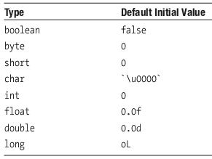
Variables Declarations
Default Initial values for primitive types
Note:
only the Member variables acquire the default values if not explicitly initialized
You must initialize the local variables explicitly before you use them in the code, otherwise you will receive a compiler error.

Slide 41
Variable Initialization
//integers
byte largestByte = Byte.MAX_VALUE;
short largestShort = Short.MAX_VALUE;
int largestInteger = Integer.MAX_VALUE;
long largestLong = Long.MAX_VALUE;
//real numbers
float largestFloat = Float.MAX_VALUE;
double largestDouble = Double.MAX_VALUE;
//other primitive types
char aChar = 'S';
boolean aBoolean = true;

Slide 42
Variables declarations
Non-primitive types or Reference types or called object reference
When you declare a variable of a non-primitive data type, you actually declare a variable that is a reference to the memory where an object lives
The name of variable refer to object is called pointer

Slide 43
Variables declarations
Arrays: (built-in object)
Arrays in Java are objects that are used to store multiple variables of the same type (primitive types or non-primitive types)
Declaring an Array Variable
int [] scores; or int scores []; or int scores [5]
Number elements
Data type
Array variable’s name

Slide 44
Variables declarations
Arrays:
Creating an Array
scores = new int[3];
Assigning Values to Array Elements
Array variables access by index
Index start from 0
scores[0] = 75;

Slide 45
Variable declaration and init
// Simple variable:
byte i;
// Many variables can have the same type declaration
float x, y, z;
int x = 1, y, z = 333_1500_24; // underscore: Java7
string name = "new name";
// Array: Indexed by an integer from Zero
int[] x = {1, 2, 3}; char[] y = new char[6]; // OK
int x1 = x[0]; // 1
int x[]; // OK too but discouraged
// Multi dimension array/Array of array:
int[][] x = {{1, 2}, {3, 4}};
int[][] y = {{1, 2}, {3, 4, 5}};
int[][][] z = {{{1, 2}, {3, 4}}, {{5, 6}, {7, 8}}};

Slide 46
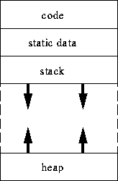
Run-time Memory

Slide 47
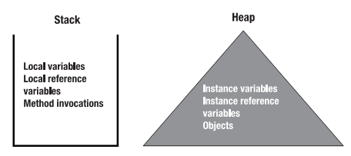
Memory Usage By Java Program

Slide 48
Memory Usage By Java Program
Stack
Local variables: The variables of primitive types defined inside a method or as method parameters
Local reference variables: The variables that refer to an object and are defined inside a method or as a method parameter. Remember that an object that a local variable refers to lives on the heap and not on the stack
Method invocations (Parameters): When you invoke (call) a method, the method is pushed onto the stack (that is, placed on top of the stack)

Slide 49
Memory Usage By Java Program
Heap
Instance variables: The variables of primitive types defined inside a class but outside of all its methods
Instance reference variables: The variables that refer to an object and are defined inside a class but outside of all its methods
Objects: Represent the entities in the real-world problem that the Java program is trying to solve. All the objects live on the heap, always
Note: the object will not die with the local reference variable

Slide 50
OPERATORS AND ASSIGNMENTS

Slide 51
Outline
Understanding Operations on Data
Operator Classification
Arithmetic Operators
Relational Operators
Logical Operators
Assignment Operators
Arithmetic Promotion
Advanced Operators
Equality of Two Objects or Two Primitives

Slide 52
Understanding Operations on Data
How can we manipulate data ?
Java offers operations
The piece of data (represented by a variable) that is being operated on is called an operand
x = y;
operand
operator

Slide 53
Operator Classification
Unary operators: Require only one operand
a++
Binary operators: Require two operands
a + b
Ternary operators: Operate on three operands
(a > 2) ? a : 2

Slide 54
Operators
The unary operators support either prefix or postfix notation. Prefix notation means that the operator appears before its operand. operator op //prefix notation
Postfix notation means that the operator appears after its operand. op operator //postfix notation
All the binary operators use infix notation, which means that the operator appears between its operands. op1 operator op2 //infix notation
The ternary operator is also infix; each component of the operator appears between operands. op1 ? op2 : op3 //infix notation

Slide 55
Arithmetic Operators
+ additive operator (also used for String concatenation)
- subtraction operator
* multiplication operator
/ division operator
% remainder operator

Slide 56
Basic Arithmetic Operators (cont.)
The accuracy of the results is limited to the type
If the result of the operations on two variables is larger than what the type can hold, the higher bits are dropped
Questions: c = (byte) a*b; //Error?
int x=10,y=0,z=x/y; // Error?
double x=10,y=0,z=x/y; // Error?
byte a = 70;
byte b = 5;
byte c = (byte) (a*b);
c = 350
101011110
01011110
94

Slide 57
Basic Arithmetic Operators (cont.)
Should be careful about accuracy while dividing two integers
The result of dividing an integer by another integer will be an integer
66 divided by 7 would be 9, and not 9.43
in case of integer types (char, byte, short, int, and long), division by zero is not allowed
int x = 2;
int y =0;
int z = x/y;
ArithmeticException in execution

Slide 58
Basic Arithmetic Operators (cont.)
Division by zero in case of float and double types does not generate an error
it would generate POSITIVE_INFINITY or NEGATIVE_INFINITY
The square root of a negative number of float or double type would generate an NaN (Not a Number) value, and will not generate an exception

Slide 59
Basic Arithmetic Operators (cont.)
An NaN value indicates that the calculation has no meaningful result
Two NaN values are defined in the java.lang package: Float.NaN, and Double.NaN
double x = 7.0/0.0;
x < Double.NaN
x <= Double.NaN
x > Double.NaN
x >= Double.NaN
x == Double.NaN
x != Double.NaN
true
false

Slide 60
Arithmetic Operators
int a = 10;
int b = 3;
int c = a/b
double d = a/b
// d = ?
d = (float) a/b;
// d = ?
d = (float) (a/b)
// d = ?

Slide 61
Unary operators

Slide 62
Example for Unary oprators
int m = 7;
int n = 7;
int a = 2 * ++m; // now a is ?, m is ?
int b = 2 * n++; // now b is ?, n is ?

Slide 63
Relational Operators
A relational operators, also called a comparison operators
A relational operator compares the values of two operands and returns a boolean value: true or false
The operand could be any of the numeric operands
The comparison operators are commonly used to define conditions in statements such as if

Slide 64
Relational Operators
Notes:
double f1=0.11f, f2=0.1f, f3=0.21f;
if (f3 == f1+f2) System.out.println("OK"); else System.out.println("Err");
System.out.println(f1+f2);

Slide 65
Logical Operators
Logical operators are used to combine more than one condition that may be true or false
Logical operators deal with connecting the boolean values
A boolean value is a binary value: true or false that can be represented by a bit 1 or 0
Logical operators can operate at bit level
Java offers two kinds of logical operators
bitwise logical operators
short-circuit logical operators

Slide 66
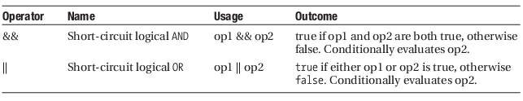
Short-Circuit Logical Operators
The outcome of these operators is, of course, a boolean true or false
The short-circuit logical operators may be used to build powerful conditions based on compound comparison

Slide 67
Short-Circuit Logical Operators
In case of short-circuit logical AND and OR operations, the second operand is only evaluated if the outcome of the overall operation cannot be determined from the evaluation of the first operand

Slide 68
Short-Circuit Logical AND: &&
Rule
op1 | op2 | op1 && op2
true | true | true
true | false | false
False | true | false
false | false | false

Slide 69
Short-Circuit Logical OR: ||
Rule
op1 | op2 | op1 || op2
true | true | true
true | false | true
False | true | True
false | false | false

Slide 70
Combining Operators
1. int i = 5;
2. int j = 10
3. int k = 15;
4. if ( (i < j) || ( k++ > j) ) {
5. System.out.println("First if, value of k: " + k);
6. }
7. if ( (i < j) && ( k++ < j) ) {
8. System.out.println("Second if, value of k: " + k);
9. }
10.System.out.println("Out of if, k:" + k);
First if, value of k: 15
Out of if, value of k: 16

Slide 71
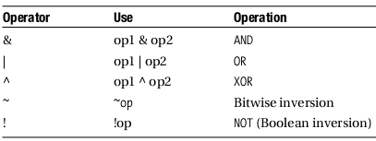
Bitwise Logical Operators
bitwise operators that are used to manipulate the bits of an integer (byte, short, char, int, long) value
These operators perform the boolean logic on a bit-by-bit basis

Slide 72
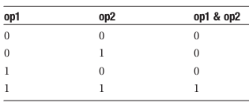
AND Operator: &
Rule
Example:
byte x = 117;
byte y = 89;
byte z = (byte) (x&y);
01110101
& 01011001
------------------
01010001 = 81

Slide 73
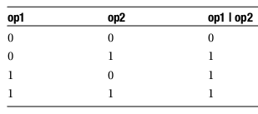
OR Operator: |
Rule
Example:
byte x = 117;
byte y = 89;
byte z = (byte) (x|y);
01110101
| 01011001
------------------
01111101 = 125

Slide 74
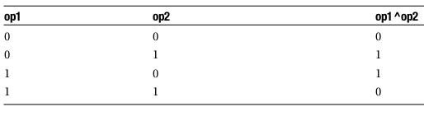
XOR Operator: ^
Rule
Example:
byte x = 117;
byte y = 89;
byte z = (byte) (x^y);
01110101
^ 01011001
------------------
00101100 = 44

Slide 75
The Bitwise Inversion Operator: ~
This unary operator inverts the value of each bit of the operand
Example:
byte x = 117;
byte z = (byte) (~x);
~ 01110101
------------------
10001010 = -118

Slide 76
The Boolean Inversion Operator: !
This unary operator operates on a boolean operand and the outcome is the inversion of the value of the operand
Note: Java doesn’t like C, C++ using number as boolean value
Example:
boolean a = true;
boolean b = !a;
b = false;

Slide 77
Bitwise operators - Sumary
int a = 13 & 12; // a = 12
int a = 13 | 12; // a = 13;
int a = 13 ^ 12; // a = 1;
int a = ~(byte)129;// a = 126

Slide 78
Shift Operators
For examples:
int a = -13 >> 1; // a = -7
int a = -13 >>> 1; // a = 2147483641
int a = 13 << 1; // a = 26
int a = -13 << 1; // a = -26

Slide 79
Assignment Operators
An assignment operator is used to set (or reset) the value of a variable
The assignment operators can be combined with other operators, and the resultant operators are called shortcut assignment operators
The operands on the two sides of an assignment operator do not have to be of the same type
int x = 7;

Slide 80
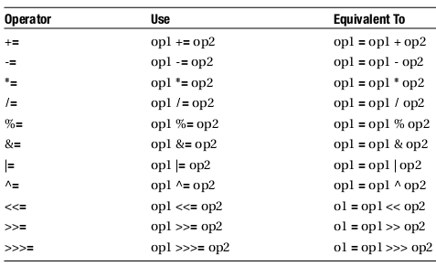
Shortcut Assignment Operators
Shortcut assignment operators that reduce down to the basic assignment operator =
x = x + y; => x += y;

Slide 81
Shortcut Assignment Operators
byte b = 3;
b += 7;
OK
byte b = 3;
b = b + 7;
Error: since b + 7 results in an int

Slide 82
Assignment Operators

Slide 83
Other Operators

Slide 84
Operators summary

Slide 85
Arithmetic Promotion
What happen when binary operations between operands of different types ?
the compiler may convert the type of one operand to the type of the other operand, or the types of both operands to entirely different types
This conversion, called arithmetic promotion, is performed before any calculation is done

Slide 86
Arithmetic Promotion (cont.)
The rules that govern arithmetic promotion in Java:
If both the operands are of a type narrower than int (that is byte, short, or char), then both of them are promoted to type int
If one of the operands is of type double, then the other operand is converted to double as well
If none of the operands is of type double, and one of the operands is of type float, then the other operand is converted to type float as well
If none of the operands is of type double or float, and one of the operands is of type long, then the other operand is converted to type long as well
If none of the operands is of type double, float, or long, then both the operands are converted to type int, if they already are not

Slide 87
Arithmetic Promotion (cont.)
byte x = 1;
byte y = 2;
What type of x / y ?
int
byte b = 5;
int i = 3;
double d = b / i;
this result is promoted to double
b is promoted to type int

Slide 88
Arithmetic Promotion (cont.)
The preceding rules imply that the result of any binary arithmetic operation would be at least of type int
Not any type can be converted to any other type
There will be situations in which you explicitly need to use an operator, called the cast operator, to convert one type to another

Slide 89
Arithmetic Promotion (cont.)
int a,b
long c;
(a*b)/b = a true/false
(a/b)*b = a true/false
(a*b)/b có tương đương (a/b)*b ???

Slide 90
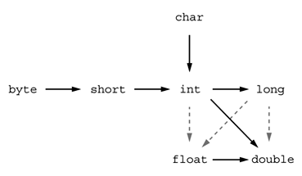
Conversions Between Numeric Types
For example, a large integer such as 123456789 has more digits than the float type can represent. When converting it to a float, it loses some precision.
int n = 123456789; float f = n; // f is 1.23456792E8

Slide 91
Number casting
// Smaller type number in memory size to
// wider one
byte b = 5;
int i = b; // i = 5
// Wider type to smaller one
int i = 500;
byte j = i; // compile error
byte j = (byte)i; // i = -12
// Range checked
byte i = (byte)(Byte.MAX_VALUE + 1); // -128
byte i = (byte)(Byte.MIN_VALUE - 1); // 127
Notes:
Binary truncate
Aware the same effect in object casting

Slide 92
Casts
The syntax for casting is to give the target type in parentheses, followed by the variable name. For example:
double x = 9.997; int nx = (int)x;
Then, the variable nx has the value 9, as casting a floating-point value to an integer discards the fractional part.
If you want to round a floating-point number to the nearest integer (which is the more useful operation in most cases), use the Math.round method:
double x = 9.997; int nx = (int)Math.round(x);
Now the variable nx has the value 10. You still need to use the cast (int) when you call round. The reason is that the return value of the round method is a long, and a long can only be assigned to an int with an explicit cast since there is the possibility of information loss.

Slide 93
The Cast Operator:(<type>)
The cast operator explicitly converts a value to the specified type
byte x = 1;
byte y = 2;
byte z = x / y;
generate a compiler error
x/y is promoted to type int but z type byte
Should write:
byte z = (byte) (x / y);

Slide 94
The instanceof Operator
The instanceof operator determines if a given object is of the type of a specific class
the instanceof operator tests whether its first operand is an instance of its second operand
The test is made at runtime
The first operand is supposed to be the name of an object or an array element, and the second operand is supposed to be the name of a class, interface, or array type

Slide 95
The instanceof Operator (cont.)
interface X{}
class A implements X {}
class B extends A {}
A a = new A();
B b = new B();
If (b instanceof X)
if (b instanceof B)
If (b instanceof A)
If (a instanceof A)
If (a instanceof X)
true

Slide 96
Operators - summary
References: . () [] new
Arithmetic: + ++ - -- * / %
Logical: & | ^ !
Conditional: && (&) || ! == != > >= < <=
Type verification: instanceof
Bitwise: ~ >> >>> <<
Assignment: = += -= *= /= %= &= |= ^= >>= <<=
Selection: ?:
Notes:
>>>: shift ignore sign – shift right with leftmost bit
>> : shift keep sign – shift right without leftmost bit

Slide 97
CONTROL FLOW STATEMENTS

Slide 98
Control Flow Statement
When writing a program, you type statements into a file. Without control flow statements, the interpreter executes the statements in the order they appear in the file from left to right, top to bottom. You can use control flow statements in your programs to conditionally execute statements; to repeatedly execute a block of statements; and to otherwise change the normal, sequential flow of control.

Slide 99
Flow control statements (fsoft)
Branching
Selection: string x = 2 == 5 ? "Yes": "No";
if… else if … else
switch … case … default
Iteration
for
do while
while
Ignore and breaking
continue
break

Slide 100
While statement
You use a while statement to continually execute a block of statements while a condition remains true. The following is the general syntax of the while statement.
while (expression) {
statement
}
First, the while statement evaluates expression, which must return a boolean value. If the expression returns true, the while statement executes the statement(s) in the while block. The while statement continues testing the expression and executing its block until the expression returns false.

Slide 101
Example for while statement
class WhileDemo {
public static void main(String[] args){
int count = 1;
while (count < 11) {
System.out.println("Count is: " + count);
count++;
}
}
}
We can implement an infinite loop using the while statement as follows:
while (true){
// your code goes here
}

Slide 102
do – while statement
do {
statement(s)
} while (expression);
Instead of evaluating the expression at the top of the loop, do-while evaluates the expression at the bottom. Thus, the statements within the block associated with a do-while are executed at least once.
int count = 1;
do {
System.out.println("Count is: " + count);
count++;
} while (count <= 11);

Slide 103
Comparing the while and do – while
while (expression) {
statement
}
do {
statement(s)
} while (expression);
statement
condition
true
true
false
condition
statement
false

Slide 104
The for Statement
Phần khởi đầu forInit
được thi hành 1 lần
trước khi bắt đầu vòng lặp
Lệnh statement được thi
hành cho đến khi điều
kiện condition là false
Từ dành
riêng
for ( forInit ; condition ; forUpdate ){
statement;
}
Phần forUpdate được thi hành cuối mỗi vòng lặp.

Slide 105
The for Statement
forInit
forInit;
while ( condition )
{
statement;
forUpdate;
}
“for” ekvivalent
condition
true
false
statement
forUpdate

Slide 106
The for Statement
for (initialization; termination; increment) { statement(s) }
The initialization expression initializes the loop; it's executed once, as the loop begins.
When the termination expression evaluates to false, the loop terminates.
The increment expression is invoked after each iteration through the loop; it is perfectly acceptable for this expression to increment or decrement a value.
for(int i=1; i<11; i++){ System.out.println("Count is: " + i); }
for ( ; ; ) { // infinite loop // your code goes here }

Slide 107
Iterating with Enhanced for

Slide 108
The if and else Statements
condition
condition
true
false
true
false
statement
statement1
statement2
if (expression) { statement1(s) } else {
statement2(s) }
if (expression) { statement(s) }

Slide 109
Example for if-else statement
public class IfElseDemo {
public static void main(String[] args) {
int testscore = 76;
char grade;
if (testscore >= 90) {
grade = 'A';
} else if (testscore >= 80) {
grade = 'B';
} else if (testscore >= 70) {
grade = 'C';
} else if (testscore >= 60) {
grade = 'D';
} else {
grade = 'F';
}
System.out.println("Grade = " + grade);
}
}

Slide 110
Switch statement
switch ( value )
{
case value_1 :
statement_list_1
case value_2 :
statement_list_2
case value_3 :
statement_list_3
default: ...
}
Use the switch statement to conditionally perform statements based on an integer expression or enumerated type (byte, short, char, and int primitive data types )
Notes:
từ jdk 1.7 value có thể là String

Slide 111
Example for switch statement
int month = 8;
switch (month) {
case 1: System.out.println("January"); break;
case 2: System.out.println("February"); break;
case 3: System.out.println("March"); break;
case 4: System.out.println("April"); break;
case 5: System.out.println("May"); break;
case 6: System.out.println("June"); break;
case 7: System.out.println("July"); break;
case 8: System.out.println("August"); break;
case 9: System.out.println("September"); break;
case 10: System.out.println("October"); break;
case 11: System.out.println("November"); break;
case 12: System.out.println("December"); break;
default: System.out.println("Not a month!");break;
}

Slide 112
Ex.: Calculte a number of days in a month
int month = 2;
int year = 2000;
int numDays = 0;
switch (month) {
case 1:
case 3:
case 5:
case 7:
case 8:
case 10:
case 12:
numDays = 31;
break;

Slide 113
Ex.: Calculte a number of days in a month
case 4:
case 6:
case 9:
case 11:
numDays = 30;
break;
case 2:
if ( ((year % 4 == 0) && !(year % 100 == 0))
|| (year % 400 == 0) )
numDays = 29; else numDays = 28;
break;
default:
numDays = 0;
break;
}
System.out.println("Number of Days = " + numDays);

Slide 114
Enumerated Types in switch Statements
public class SwitchEnumDemo {
public enum Month { JANUARY, FEBRUARY, MARCH, APRIL,
MAY, JUNE, JULY, AUGUST, SEPTEMBER,
OCTOBER, NOVEMBER, DECEMBER }
public static void main(String[] args) {
Month month = Month.FEBRUARY;
int year = 2000;
int numDays = 0;
switch (month) {
case JANUARY:
case MARCH:
case MAY:
case JULY:
case AUGUST:
case OCTOBER:
case DECEMBER:
numDays = 31;
break;

Slide 115
Enumerated Types in switch Statements
case APRIL:
case JUNE:
case SEPTEMBER:
case NOVEMBER:
numDays = 30;
break;
case FEBRUARY:
if ( ((year % 4 == 0) && !(year % 100 == 0))
|| (year % 400 == 0) )
numDays = 29;
else
numDays = 28;
break;
default:
numDays=0;
break;
}
System.out.println("Number of Days = " + numDays);
}
}

Slide 116
Branching Statements
The Java programming language supports the following branching statements:
The break statement
The continue statement
The return statement
The break and continue statements, which are covered next, can be used with or without a label. A label is an identifier placed before a statement; it is followed by a colon (:). statementName : someStatement;

Slide 117
The break Statements
The break statement has two forms:
unlabeled form: The unlabeled form of the break statement was used with switch earlier. As noted there, an unlabeled break terminates the enclosing switch statement, and flow of control transfers to the statement immediately following the switch. That is mean unlabeled break terminates the enclosing loop. The unlabeled form of the break statement is used to terminate the innermost switch, for, while, or do-while statement;
labeled form: the labeled form terminates an outer statement, which is identified by the label specified in the break statement.

Slide 118
Unlabled break statement
public class BreakContinue extends TestCase{
public void test(){
int out,in=0;
for (out = 0 ;out<10; out++){
for (in =0; in<20; in++){
if (in>10) break;
}
System.out.println("inside the outer loop: out = " + out + ", in = " + in);
}
System.out.println("end of the outer loop: out = " + out + ", in = " + in)
}
}
What do you see?

Slide 119
Labeled break statement
public class BreakContinue extends TestCase{
public void test(){
int out,in=0;
outer:
for (out = 0 ;out<10; out++){
for (in =0; in<20; in++){
if (in>10) break outer;
}
System.out.println("inside the outer loop: out = " + out + ", in = " + in);
}
System.out.println("end of the outer loop: out = " + out + ", in = " + in)
}
}
What do you see?

Slide 120
The continue Statement
The continue statement is used to skip the current iteration of a for, while , or do-while loop. The unlabeled form skips to the end of the innermost loop's body and evaluates the boolean expression that controls the loop, basically skipping the remainder of this iteration of the loop.
The labeled form of the continue statement skips the current iteration of an outer loop marked with the given label.

Slide 121
Unlabled continue statement
StringBuffer searchMe = new StringBuffer(
"peter piper picked a peck of pickled peppers");
int max = searchMe.length();
int numPs = 0;
System.out.println(searchMe);
for (int i = 0; i < max; i++) {
//interested only in p's
if (searchMe.charAt(i) != 'p') continue;
//process p's
numPs++;
searchMe.setCharAt(i, 'P');
}
System.out.println("Found " + numPs
+ " p's in the string.");
System.out.println(searchMe);
}

Slide 122
The result of mentioned example
peter piper picked a peck of pickled peppers
Found 9 p's in the string.
Peter PiPer Picked a Peck of Pickled PePPers

Slide 123
The Labeled continue statement
//finds a substring(substring) in given string(serchMe)
String searchMe = "Look for a substring in me";
String substring = "sub";
boolean foundIt = false;
int max = searchMe.length() - substring.length();
test:
for (int i = 0; i <= max; i++) {
int n=substring.length(), j=i, k= 0;
while (n-- != 0) {
if(searchMe.charAt(j++)!= substring.charAt(k++)){
continue test;
}
}
foundIt = true;
break test;
}
System.out.println(foundIt ? "Found it" :"Didn't find it");
}

Slide 124
The return Statement
The return statement has two forms: (1) one that returns a value and (2) one that doesn't. To return a value, simply put the value (or an expression that calculates the value) after the return keyword.
return ++count;
The data type of the value returned by return must match the type of the method's declared return value. When a method is declared void, use the form of return that doesn't return a value
return;

Slide 125
The first form of “return” statement
public boolean seachFirst(){
int[] array = {10,5,9,3,8,5,8,5};
int matchValue = 8;
for (int i=0; i<array.length; i++){
if (matchValue == array[i]) return true;
}
return false;
}

Slide 126
2. form of “return” Statement (version 1)
public void displayDayOfWeek(int day){
if (day == 1){
System.out.println("Sunday");
return;
}
if (day == 2){
System.out.println("Monday");
return;
}
if (day == 3){
System.out.println("Tueday");
return;
}
if …………………….
}

Slide 127
2. form of “return” Statement (version 2)
public void displayDayOfWeek(int day){
if (day == 1){
System.out.println("Sunday");
} else if (day == 2){
System.out.println("Monday");
} else if (day == 3){
System.out.println("Tueday");
} else .....
}
Which version do you like?

Slide 128
Summary
Key words: int, new, string, boolean…
Primitive types: int, boolean, string…
Variable: simple and array
Operators: arithmetical, conditional…
Branching statements: if, switch, selection
Iterate statements: for, while, do while

Slide 129
STRING LITERAL

Slide 130
String literal
// Declaration and initialization
// "\" start an "escape" code
String s1 = "a\n", s2 = "\"", s3 = s2;
// assignment
s2 = s1;
// concatenation
s3 = s1 + s3;
Notes:
Operation on String will be presented in next day

Slide 131
Escape code
\f | Formfeed | \" | Double quotation mark
\n | New line | \\ | Backslash
\r | Carriage return | \ooo | ASCII character in octal notation
\t | Horizontal tab | \x hh | ASCII character in hexadecimal notation
\' | Single quotation mark | \x hhhh | Unicode in herxadeximal

Slide 132
SYSTEM I/O

Slide 133
Console I/O
// Write:
System.out.println(StrFormat, variableList);
// Read:
InputStreamReader sr = new InputStreamReader(System.in);
BufferedReader input = new BufferedReader(sr);
String line = input.readLine();
Notes:
Dùng lớp Scanner không nói nhiều về luồng.

Slide 134
STRING FORMAT

Slide 135
String format
String header = String.format(
"%1$-12s %2$8s %3$12s %2$8s %3$12s %4$14s\n", // pattern string
"City", "Year", "Population", "Change (%)"); // argument list
String body = String.format(
"%1$-12s %2$8tY %3$,12d %4$8tY %5$,12d %6$12.1 %%\n",
Name, BaseYear, BasePopulation, ObserveYear, ObservePopulation,
ObservePopulation – BasePopulation)/ (double) BasePopulation);
// Sample output
City Year Population Year Population Change (%)
-----------------------------------------------------------------------
Los Angeles 1940 1,504,277 1950 1,970,358 31.0 %
New York 1940 7,454,995 1950 7,891,957 5.9 %
Chicago 1940 3,396,808 1950 3,620,962 6.6 %
Detroit 1940 1,623,452 1950 1,849,568 13.9 %
Notes:
String format is used to replace the parameter into place holder with the needed format
Attention to header, argument used twice, first argument is left aligned
BaseYear and Observed Year is in Date type
Present the use of pattern

Slide 136
Number pattern in string format
'd' | decimal integer
'o' | octal integer
'x', 'X' | hexadecimal integer
'e', 'E' | decimal number in computerized scientific notation
'f' | decimal floating point number
'g', 'G' | computerized scientific notation or decimal format depending on the precision and the value after rounding.
'a', 'A' | hexadecimal floating-point number with a significant and an exponent
Notes:
Number format directive list

Slide 137
Date time pattern in string format
't','T' | date and time format required prefix |  | 'C' | Century in two digit format 00 - 99
'H' | Hour in 24-hour two digit format 00-23 |  | 'Y' | Year in four digit format 2013
'I' | Hour in 12-hour two digit format 00-12 |  | 'y' | year in two digit format 00 - 99.
'M' | Minute in two digit format 00 - 59 |  | 'j' | Day of year in three digit format 001 - 366
'S' | Seconds in two digit format 00 - 60 |  | 'm' | Month in two digit format 01 - 12.
'L' | Millisecond in three digit format 000 - 999. |  | 'd' | Day of month in two digit format 01 - 31
'N' | Nanosecond in nine digit format 000000000 - 999999999. |  | 'R' | "%tH:%tM"
'p' | morning or afternoon marker "am"/"pm" |  | 'T' | "%tH:%tM:%tS".
'B','h' | Full month name, "January", "February". |  | 'r' | "%tI:%tM:%tS %Tp"
'b' | Abbreviated month name, "Jan", "Feb". |  | 'D' | "%tm/%td/%ty".
'A' | full name of the day in the week, "Sunday", "Monday" |  | 'F' | "%tY-%tm-%td".
'a' | short name of the day in the week, "Sun", "Mon" |  | 'c' | "%ta %tb %td %tT %tZ %tY"
Notes:
Date and time string format directive

Slide 138
USING DATE AND TIME

Slide 139
Date and Time
import java.util.Date;
import java.text.SimpleDateFormat;
SimpleDateFormat df = new SimpleDateFormat(
"yyyy-MM-dd hh:mm:ss.SSS");
try{
Date d1 = df.parse("1940-01-01 15:28:31.976");
Date d2 = df.parse("2014-13-36 36:65:82.976");
String s = df.format(d2);
// "2015-02-06 13:06:22.976"
} catch(ParseException e){
}

Slide 140
Date/Time pattern in SimpleDateFormat
y | Year | 1996; 96
M | Month in year | July; Jul; 07
w | Week in year | 27
W | Week in month | 2
D | Day in year | 189
d | Day in month | 10
F | Day of week in month | 2
E | Day in week | Tuesday; Tue
a | Am/pm marker | PM
H, h | Hour in day (0-23/0-12) | 15, 12
k, K | H, h | 24
m | Minute in hour | 30
s | Second in minute | 55
S | Millisecond | 978
Z, Z | Full/Sort time zone | Pacific Standard Time; PST; GMT-08:00/-0800
Notes:
Date and time string format directive

Slide 141
Exception Handling

Slide 142
Objectives
Introduce exception handling in Java
To ensure error handling is correctly done

Slide 143
Contents
Prerequisite Thinking
Exception
Exception Usage
Traditional Error Handling vs. Exception
Create Exceptions
Throw Exceptions
Guidelines

Slide 144
Prerequisite Thinking
Errors occur in software programs.
What really matters is what happens after the errors occur.
Errors must be handled by developers.
Errors should be reported to application users and the system administrators.
Application should recover after errors. It should not just die.

Slide 145
Exception
Definition: An exception is an event that occurs during the execution of a program that stops the normal flow of instructions.[1]
Concept: Exceptions are the customary way in Java to indicate to a calling method that an abnormal condition has occurred.[3] An error, in a program, is an abnormal condition[1].
Thus they should be shown up as exceptions

Slide 146
Exception
Throwing Exception: when you want to stop the flow of instructions because of an abnormal condition, you can throw an exception. This exception is sent from the context of the method to that of its invokers.
Catching Exception: When you are in the context of the invoker of a method that throws an exception and you want to handle it, you catch it. This exception is no more thrown up to your invokers/callers.

Slide 147
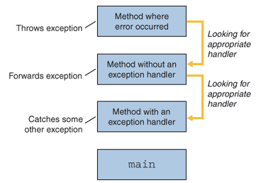
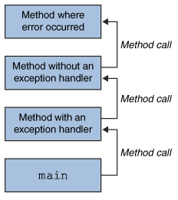
Exception – Call stack

Slide 148
Exception Usage
The calling method can do one of three things below with exceptions:[3]
It can call the method from within a try { } catch {} block and catch the exception to handle it.
It can decide not to handle the exception and declare that it throws itself the same exception via the throws <ExceptionName> clause.
It can catch the exception, do possibly some partial exception handling and then re-throw the same exception or throw another exception.

Slide 149
Exception Usage
Employee m_emp;
//…
public void modifyEmployee(){
//…collect information from GUI to the object m_emp
try{
empService.modifyEmployee(m_emp);
}catch(EmployeeModifiedByAnotherException emae){
//Shows message to the user to reload the employee data
}
}
public void modifyEmployee(Employee emp) throws EmployeeModifiedByAnotherException{
empDAO.updateEmployee(emp);
}
public void modifyEmployee(Employee emp) throws EmployeeModifiedByAnotherException{
try{
empDAO.updateEmployee(emp);
}catch(EmployeeModifiedByAnotherException emae){
//log this event into a file
throws emae;
}
}

Slide 150
Exception-Handling Statements
The try statement identifies a block of statements within which an exception might be thrown.
The catch statement must be associated with a try statement and identifies a block of statements that can handle a particular type of exception.
The finally statement must be associated with a try statement and identifies a block of statements that are executed regardless of whether or not an error occurs within the try block.
try {
statement(s)
} catch (exceptiontype name) {
statement(s)
} catch (exceptiontype name) {
statement(s)
} finally {
statement(s)
}

Slide 151
Exceptions Thrown by a Method
// Note: This method won't compile by design!
public void writeList() {
PrintWriter out = new PrintWriter(new FileWriter("OutFile.txt"));
for (int i = 0; i <= SIZE; i++) {
out.println("Value at: " + i + " = " + victor.elementAt(i));
}
out.close();
}
public void writeList() throws IOException, ArrayIndexOutOfBoundsException {
Remember that ArrayIndexOutOfBoundsException is a runtime exception, so you don't have to specify it in the throws clause, although you can. You could just write the following.
public void writeList() throws IOException {

Slide 152
Using the try and catch Blocks
public class ExceptionHandle{
public static void main(String[] args) {
int x = 15;
int y = 0;
try{
System.out.println ("x/y: " + x/y);
System.out.println("x*y: " + x*y);
}
catch (ArithmeticException ae) {
System.out.println("An exception occurred: " + ae);
}
System.out.println("x-y: " + (x-y));
}
}

Slide 153
Using the try and catch Blocks
If an exception is thrown from the try block and an appropriate catch block (to catch the exception) did not exist, the method would be terminated
Example: If we replace the line catch in to
catch (ArrayIndexOutOfBoundsException oe)
What happen ?

Slide 154
Using the try and catch Blocks
It is possible to have multiple catch blocks,
try { } catch (ExceptionType name) { } catch (ExceptionType name) { }
Each catch block is an exception handler and handles the type of exception indicated by its argument. The argument type, ExceptionType, declares the type of exception that the handler can handle and must be the name of a class that inherits from the Throwable class.

Slide 155
Using the try and catch Blocks
The only catch block that catches the exception is executed
If there is no matching catch block for the checked exception and the method does not throw the exception by using the throws clause, the code will not compile
If there is no matching catch block for an unchecked exception, the execution will leave the method

Slide 156
Using Multiple catch Blocks
public class MultipleExceptions{
public static void main(String[] args) {
int[] x = {0, 1, 2, 3, 4};
try{
System.out.println ("x[6]: " + x[6]);
System.out.println("x[3]: " + x[3]);
}catch (ArithmeticException ae) {
System.out.println("An arithmetic exception occurred: " + ae);
}catch (ArrayIndexOutOfBoundsException oe) {
System.out.println("Array index out of bound! ");
}catch (IndexOutOfBoundsException ie) {
System.out.println("Some kind of index out of bound! ");
} finally {
System.out.println("finally block must be executed!");
}
System.out.println("x[0]: " + x[0]);
}
}

Slide 157
Using the finally Block
public class ExceptionHandle2{
public static void main(String[] args) {
int x = 15;
int y = 0;
try{
System.out.println ("x/y: " + x/y);
System.out.println("x*y: " + x*y);
}
catch (ArrayIndexOutOfBoundsException oe) {
System.out.println("An exception occurred: " + oe);
}
finally {
System.out.println("finally block must be executed!");
}
System.out.println("x-y: " + (x-y));
}
}

Slide 158
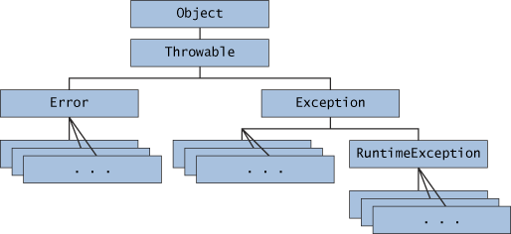
Exception Hierarchy[3]

Slide 159
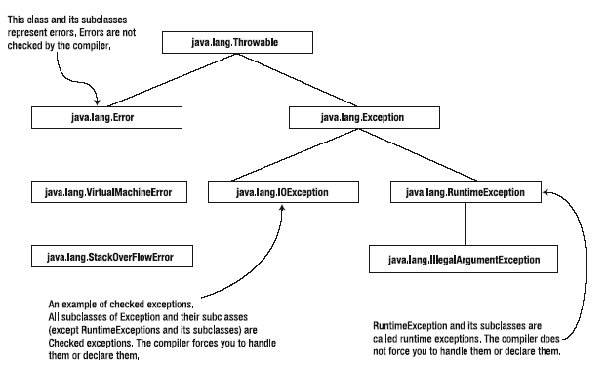
Exception Tree in Java

Slide 160
Exception Classification
Exceptions are classified into two categories
Checked exceptions
Runtime exceptions
Checked exceptions
This is the category of exceptions for which the compiler checks
To ensure that your code is prepared for them: prepare for unwelcome but expected guests
Checked exceptions are generally related to how the program interacts with its environment
URISyntaxException and ClassNotFoundException are checked exceptions
You are required to handle the checked exceptions in your code

Slide 161
Exception Classification
Runtime exceptions
The exceptions of type RuntimeException occur due to program bugs
A runtime exception occurs as a result of incorrect code
they are mostly thrown by the JVM
you can throw or catching exceptions and recover from it, or you can catch it and rethrow it after doing something with it
Just throwing exceptions without catching it is also called ducking it

Slide 162
Exception Types (Fsoft)
Checked and Unchecked Exceptions
Checked Exceptions must be handled in one of the three ways above otherwise Java compiler complains.
Unchecked Exceptions (Runtime Exceptions) can also be handled in the same ways. However the compiler does not require their handling.

Slide 163
Error Class
java.lang.Error is a subclass of Throwable that indicates serious problems that a reasonable application should not try to catch.
Example: The OutOfMemoryError error shows no more memory for JVM to run
A method is not required to declare in its throws clause any subclasses of Error that might be thrown during the execution of the method but not caught, since these errors are abnormal conditions that should never occur.

Slide 164
Catching Exceptions
catch(ExceptionName e){} block is an exception handler. It allows developers to write code that handles the exception.
One try can have many catch blocks.
One thrown exception can match multiple catch blocks. However the first matching catch block is the only handler according to the order of the appearance of catch blocks in the code.

Slide 165
Catching Exceptions
IllegalArgumentException
try{
Integer.parseInt(“XX”);
}
catch(IllegalArgumentException iae){
//Handle iae
}
catch(NumberFormatException nfe){
//This code is never called
}
NumberFormatException

Slide 166
Catching Exceptions
Remarks:
Catch the most precisely specialized exception rather than its superclass.
catch block must not be empty
Order catch blocks according to the predicted number of the exception occurrence. The greatest is first. This is not applied to parent exceptions over their children.
Do not use try catch to perform the flow control.
Iterator i = empCollection.iterator();
Employee emp;
for(;;){
try(
emp = i.next();
emp.program();
}catch(NoSuchElementException e){
break;
}
}
Iterator I = empCollection.iterator();
Employee emp;
while(i.hasNext()){
emp = i.next();
emp.program();
}

Slide 167
Stack Trace
Stack trace is the list of methods that consecutive called down to the one that throws the exception
Stack trace can be visualizable
Useful for debug and logging

Slide 168
Read Stack Trace
public class MyApp {
public static void main(String[] args) {
try {
doSomething();
} catch (MyNumberFormatException e) {
e.printStackTrace();
}
}
private static void doSomething() throws MyNumberFormatException{
try {
Integer.parseInt("xxx");
} catch (NumberFormatException e) {
throw new MyNumberFormatException("Not an integer", e);
}
}
}
class MyNumberFormatException extends Exception{
public MyNumberFormatException(String msg, Throwable orgEx){
super(msg, orgEx);
}
}

Slide 169
Read Stack Trace
test.MyNumberFormatException: Not an integer
at test.MyApp.doSomething(MyApp.java:28)
at test.MyApp.main(MyApp.java:18)
Caused by: java.lang.NumberFormatException: For input string: "xxx"
at java.lang.NumberFormatException.forInputString(NumberFormatException.java:48)
at java.lang.Integer.parseInt(Integer.java:468)
at java.lang.Integer.parseInt(Integer.java:518)
at test.MyApp.doSomething(MyApp.java:26)
... 1 more

Slide 170
Throwing Exceptions
The programmer may also throw exceptions using the keyword throw
You can either throw a caught exception that originated somewhere else or originate an exception

Slide 171
Throwing Exceptions
double x = 3.0, y = 0.0;
double z;
try{
if (y==0.0) {
throw new ArithmeticException("Integer or not,”
+ “ please do not divide by zero!");
} else {
z = x / y;
}
}catch(ArithmeticException e){
System.out.println("An exception occurred: " + ae.getMessage());
}

Slide 172
Checked Exception: Duck It or Catch It
If your method calls another method that throws a checked exception, then your method must either duck it or catch it.
Ducking it simply means to declare it with the throws clause in the method declaration and to have no try-catch blocks in the method body
Catching it means having try-catch blocks in the method body for that exception
When you catch an exception, you can either recover from it or throw it from inside the catch block

Slide 173
Checked Exception: Duck It or Catch It
void callingMethod() {
calledMethod();
}
void calledMethod() throws IOException {
throw new IOException();
}
Error: callingMethod() method neither declares
IOException nor catches it

Slide 174
Advantages of Exceptions
Advantage 1: Separating Error-Handling Code From “Regular” Code
Advantage 2: Propagating Errors Up the Call Stack
Advantage 3: Grouping and Differentiating Error Types

Slide 175
Advantages of Exceptions: Separating Error
1. Separating error handling code from „regular” code.
Suppose that you have a function that reads an entire file into memory.
In pseudo-code, your function might look something like this:
readFile {
open the file;
determine its size;
allocate that much memory;
read the file into memory;
close the file;
}
This code seems nice and enough.

Slide 176
Advantages of Exceptions: Separating Error
At first glance this function seems simple enough, but it ignores all of these potential errors:
What happens if the file can't be opened?
What happens if the length of the file can't be determined?
What happens if enough memory can't be allocated?
What happens if the read fails?
What happens if the file can't be closed?

Slide 177
Traditional Error Handling
errorCodeType readFile {
initialize errorCode = 0;
open the file;
if (theFileIsOpen) {
determine the length of the file;
if (gotTheFileLength) {
allocate that much memory;
if (gotEnoughMemory) {
read the file into memory;
if (readFailed) { errorCode = -1; }
} else { errorCode = -2; }
} else { errorCode = -3; }
close the file;
if (theFileDidntClose && errorCode == 0) { errorCode = -4; }
else { errorCode = errorCode and -4; } }
else { errorCode = -5; }
return errorCode; }

Slide 178
errorCodeType readFile {
initialize errorCode = 0;
open the file;
if (theFileIsOpen) {
determine the length of the file;
if (gotTheFileLength) {
allocate that much memory;
if (gotEnoughMemory) {
read the file into memory;
if (readFailed) {
errorCode = -1;
}
} else {
errorCode = -2;
}
} else {
errorCode = -3;
}
close the file;
if (theFileDidntClose && errorCode == 0) {
errorCode = -4;
} else {
errorCode = errorCode and -4;
}
} else {
errorCode = -5;
}
return errorCode;
}

Slide 179
Advantages of Exceptions: Separating Error
readFile {
try {
open the file;
determine its size;
allocate that much memory;
read the file into memory;
close the file;
} catch (fileOpenFailed) {
doSomething;
} catch (sizeDeterminationFailed) {
doSomething;
} catch (memoryAllocationFailed) {
doSomething;
} catch (readFailed) {
doSomething;
} catch (fileCloseFailed) {
doSomething;
}
}

Slide 180
Advantages of Exceptions 2: Propagating Errors
2. Propagating errors up the call stack
Lets suppose than only method1 is interested in errors occured during reading the file
method1 {call method2;}
method2 {call method3;}
method3 {call readFile;}
Traditional error notification techniques force method2 and method3 to propagate the error codes returned by readFile up the call stack until the error codes finally reach method1- the only method that is interested in them

Slide 181
Advantages of Exceptions 2: Propagating Errors
method1 {
errorCodeType error = call method2;
if (error)
doErrorProcessing;
else
proceed;
}
errorCodeType method2 {
errorCodeType error = call method3;
if (error)
return error;
else
proceed;
}
errorCodeType method3 {
errorCodeType error = call readFile;
if (error)
return error;
else
proceed;
}

Slide 182
Advantages of Exceptions 2: Propagating Errors
method1 {
try {
call method2;
} catch (exception e) {
doErrorProcessing;
}
}
method2 throws exception {
call method3;
}
method3 throws exception {
call readFile;
}

Slide 183
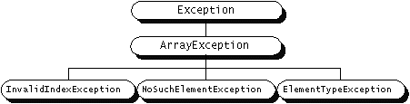
Exceptions advantages 3
3. Grouping Error Types and Error Differentiation.
Because all exceptions thrown within a program are objects, the grouping or categorizing of exceptions is a natural outcome of the class hierarchy.
For example ArrayException is a subclass of Exception (a subclass of Throwable) and has three subclasses:

Slide 184
Exceptions advantages 3
An exception handler that handles only invalid index exceptions has a catch statement like this:
catch (InvalidIndexException e) { . . . }
To catch all array exceptions regardless of their specific type, an exception handler would specify an ArrayException argument:
catch (ArrayException e) { . . . }
It is possiblel to set up an exception handler that handles any Exception with this handler:
catch (Exception e) { . . . }
It is not recommended writing general exception handlers as a rule.

Slide 185
Exception Handling
Remarks:
Never declare a method to throw directly Exception or Throwable.
Declare to throw the most-derived exceptions.
Example:
f() throws Ex1Sub1, Ex1Sub2, Ex2Sub1
Exception
Ex1
Ex2
Ex1Sub1
Ex1Sub2
...
Ex2Sub1

Slide 186
Creating Your Own Exceptions
Created by extending the Exception class
Can contain anything that a regular class contains
Example
public class MyException extends Exception {
private int no;
public MyException(String reason, int n) {
super(reason);
this.no = n;
}
//To throw an exception created by you
throw new MyException(“Message”,100);

Slide 187
Create your own Exception
Your exception should shows the necessary context information
The exception name must be clear about the reason (nature) of the exception
public class InsufficientCreditException extends Exception{
private int m_orderNum;
private int accountNum;
private String m_ownerName;
public InsufficientCreditException(String msg, int orderNum, int accountNum, String ownerName){
//Message msg should be used for development only
super(msg);
m_orderNum = orderNum;
m_accountNum = accountNum;
m_ownerName = ownerName;
}
}

Slide 188
Create your own Exception
The following exception creation is not good:
class MyException extends Exception{
String m_reason;
public MyException(){}
public MyException(String reason){
super(reason);
m_reason = reason;
}
}
throw new MyException(“Number format is wrong”);
throw new MyException(“1234:Connection lost”);
throw new MyException(“1234”);
Good creation:
class <Reason>Exception extends Exception{//…}

Slide 189
Throw Exception
Throw:
if (accout.getBalance < withdrawnAmmount)
throw new InsufficientCreditException(
orgEx.getMessage(),
account.getOrderNum()
account.getAccountNum(),
account.getOwnerName());
Re-throw:
catch (InsufficientCreditException ice) {
//do some handling such as logging
throw ice;
}

Slide 190
Translate Exception
class MyException extends Exception{
public MyException(String msg, Throwable t){
super(msg, t);
}
}
try{
//do something that can raise YourException
}
catch (YourException e) {
throw new MyException(“my own message”, e);
}

Slide 191
Exception Layers
Like application layers, in a good design application, for each layer there should be some related exceptions.
Presentation Exceptions
Business Exceptions Your own Exceptions
Data Exceptions
Technical Exceptions
Normally, all exceptions should be thrown up to presentation layer. They are handled here to report to application users.
Any uncaught exception, to the Application Layer, must be caught and handled here.

Slide 192


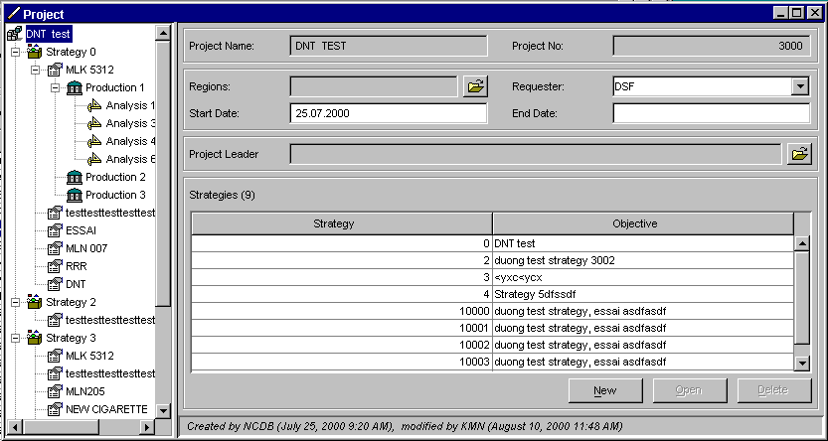
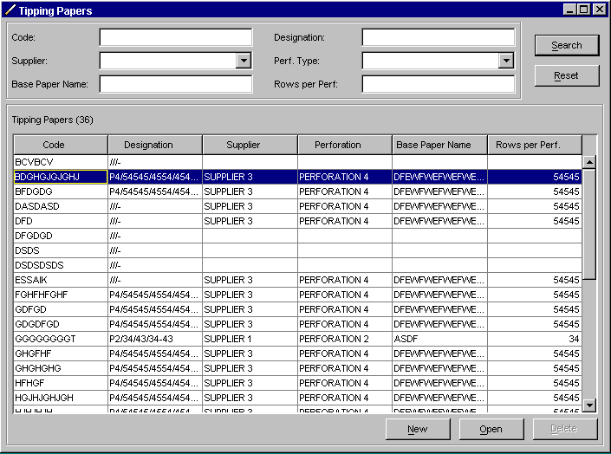
Handling error (Recall)
GUI
Error messages
Errors while treating data input
GUI layer Error Handling
Thrown business exceptions
Log
Business
Errors while treating in business layer
Business Error Handling
Database error codes
Database errors while executing
Database Error Handling
(controled by DBMS)
Database

Slide 193
Exception Precautions[2]
Once overriding method you can throw only exceptions thrown by the method in the base-class, or subclasses of the exception.
Stop instruction flow right away. This leads to non-released resources such as leak of network connections, and leak of opened file. Example:
try{
//open resources except memory
//do something that raises MyException
//release resources except memory
}
catch(MyException me) {
System.out.prinln(“My Exception occurs”);
//there is no more code to release resources
}

Slide 194
Finally Clause
Block of code executes whether or not an exception occurs in a try block. For instance the code to solve the second precaution of the exception in the previous slide.
Java provides a keyword finally along with try and catch.
try{//…}
catch(){//…}
//… other catches
finally{
//Stuffs that happens all the time
}

Slide 195
Finally Clause
MyConnection con = null;
try{
//open resources
con = new MyConnection();
//do something that raises MyException
}
catch(MyException me) {
System.out.prinln(“My Exception occurs”);
}
finally{
//code which is executed all the time here
if(con!=null)
con.close(); //release opened resources
}

Slide 196
Finally Clause
readFile {//Correct exception handling
try {
open the file;
determine its size;
allocate that much memory;
read the file into memory;
//close the file;
} catch (fileOpenFailed) {
doSomething;
} catch (sizeDeterminationFailed) {
doSomething;
} catch (memoryAllocationFailed) {
doSomething;
} catch (readFailed) {
doSomething;
} catch (fileCloseFailed) {
doSomething;
} finally {
close the file;
}
}

Slide 197
Finally Precautions
Exception loss
MyConnection con = null;
try{
//open resources
}
finally{
if(con!=null)
con.close(); //close open resources
}
if con.close()raises an exception, X, then MyException is lost and X is thrown instead.
Must catch exceptions in finally clauses but do not throw, re-throw or translate it.
Should not return in finally clause

Slide 198
Exception Guidelines[3]
Use Exception to
signal abnormal situations (exceptional situations) to the caller to react to these situations.
indicate that its caller has violated the method calling contract. For instance the caller gives a wrong argument list to the method.

Slide 199
Checked vs. Unchecked[3]

Slide 200
Guidelines[3]
Wrap Exceptions from a thrown exception (Translate Exception). This could be recursive.
Wrapping and wrapped exceptions can be both checked or unchecked.
Add attributes to exception classes to give more information about the exception. Ie. Name of the file that could not be opened.
Declare even Unchecked exceptions in a throws clause
Mention unchecked exceptions in javadoc
Design exception hierarchy for complex error cases

Slide 201


